Slide 1
MATLAB

Slide 2
Matlab
Stands for MATrix LABoratory
Interpreted language
Scientific programming environment
Very good tool for the manipulation of matrices
Great visualisation capabilities
Loads of built-in functions
Easy to learn and simple to use

Slide 3
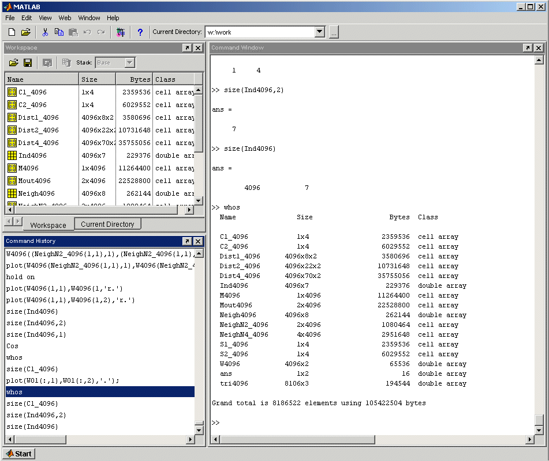

Matlab Desktop
Workspace / Current Directory
Command Window
Command History
Explore the Matlab Desktop

Slide 4
Variables
Don’t have to declare type
Don’t even have to initialise
Just assign in command window
>>
>> a=12; % variable a is assigned 12
Matlab prompt
comment operator
suppress command output
assign operator
Try the same line without the semicolon and comments

Slide 5
Variables (continued …)
View variable contents by simply typing the variable name at the command prompt
>> a
a =
12
>>
>> a*2
a =
24
>>

Slide 6
Workspace
The workspace is Matlab’s memory
Can manipulate variables stored in the workspace
>> b=10;
>> c=a+b
c =
22
>>

Slide 7
Workspace (continued …)
Display contents of workspace
>> whos
Name Size Bytes Class
a 1x1 8 double array
b 1x1 8 double array
c 1x1 8 double array
Grand total is 3 elements using 24 bytes
>>
Delete variable(s) from workspace
>> clear a b; % delete a and b from workspace
>> whos
>> clear all; % delete all variables from workspace
>> whos

Slide 8
Matlab help commands
help
>> help whos % displays documentation for the function whos
>> lookfor convert % displays functions with convert in the first help line
Start Matlab help documentation
>> helpdesk

Slide 9
Matrices
Don’t need to initialise type, or dimensions
>>A = [3 2 1; 5 1 0; 2 1 7]
A =
3 2 1
5 1 0
2 1 7
>>
square brackets to define matrices
semicolon for next row in matrix

Slide 10
Manipulating Matrices
A =
3 2 1
5 1 0
2 1 7
Access elements of a matrix
>>A(1,2)
ans=
2
Remember Matrix(row,column)
Naming convention Matrix variables start with a capital letter while vectors or scalar variables start with a simple letter
indices of matrix element(s)

Slide 11
The : operator and matrices
>>A(3,2:3)
ans =
1 7
>>A(:,2)
ans =
2
1
1
A =
3 2 1
5 1 0
2 1 7
What’ll happen if you type A(:,:) ?

Slide 12
Manipulating Matrices
A =
3 2 1
5 1 0
2 1 7
>> A ' % transpose
>> B*A % matrix multiplication
>> B.*A % element by element multiplication
>> B/A % matrix division
>> B./A % element by element division
>> [B A] % Join matrices (horizontally)
>> [B; A] % Join matrices (vertically)
B =
1 3 1
4 9 5
2 7 2
Enter matrix B into the Matlab workspace
Create matrices A and B and try out the the matrix operators in this slide

Slide 13
Flow Control: If…Else
Example: (if…else and elseif clauses)
if temperature > 100
disp (‘Too hot – equipment malfunctioning.’)
elseif temperature > 90
disp (‘Normal operating range.’);
else
disp (‘Too cold – turn off equipment.’)
end

Slide 14
Request user input:
prompt = 'What is the original value? ';
x = input(prompt)
y = x*10

Slide 15
More flow control
While statement block
while expression
statements
End
Eg:i=2;
while i<100
i=i*i
end
i =
4
i =
16
i =
256

Slide 16
For loop:
for index = values
statements
end
Eg:
for a = 10:20
fprintf('value of a: %d\n', a);
end

Slide 17
I=imread(‘pout.tif’);
Imshow(I);

